Slide 1


Dawki ICP: Northeast India’s Gateway to Regional and Global Trade
Strategic Assessment of Northeast India's Trade Gateway to Bangladesh
Presented By : Vachan Ambati
Date: 26th August 2025.
Land Ports Authority of India (LPAI) Internship Programme | August 2025

Slide 2
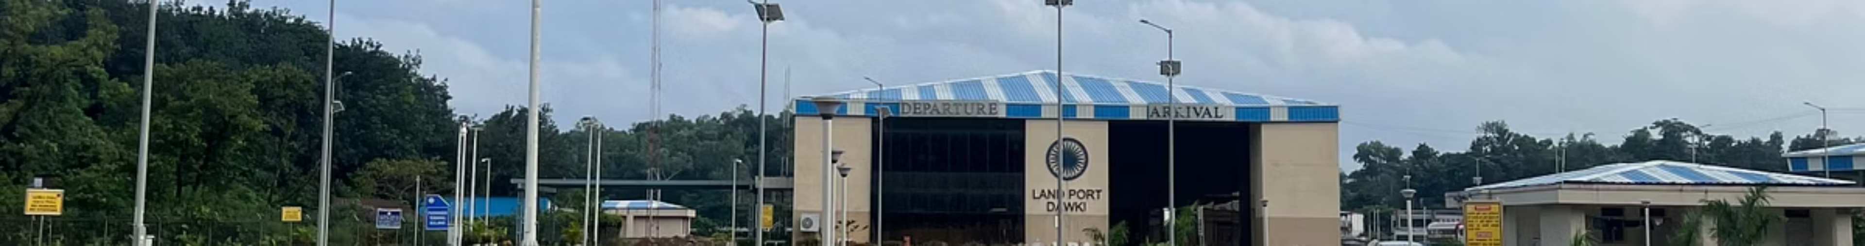
Introduction & Global Context: Dawki ICP as a Strategic Gateway.
Strategic Position: Dawki ICP anchors India’s Act East Policy and BBIN integration, serving as the critical node on the Dawki–Tamabil corridor that links Northeast India directly with Bangladesh and beyond.
Modernization: Since May 2023, Dawki has been transformed from a basic border crossing into a digitally-enabled Integrated Check Post, repositioning it as a trade facilitation hub.
Global Evidence:
World Bank (2016) – Efficient land ports cut clearance times & costs, boosting competitiveness.
ADB SASEC Plan (2016–25) – Identifies Dawki–Tamabil as a gateway corridor for Northeast India.
UNESCAP (2020) – Highlights digitization & paperless trade as the fastest route to efficiency.
ERIA (2016) – Calls for BBIN corridors to integrate with the IMT Trilateral Highway, linking Northeast India to ASEAN markets.
Strategic Potential: At just 427 km from Chattogram Port, Dawki is positioned to deliver seamless multimodal access to ASEAN. India’s PM Gati Shakti plan strengthens this corridor, unlocking new economic frontiers for Northeast India.
Policy Alignment: Dawki’s upgrades, paired with Bangladesh’s modernization at Tamabil, establish symmetric capacity, enabling balanced flows, reduced logistics costs, and reinforcing Dawki as a vital external gateway under Act East.

Slide 3
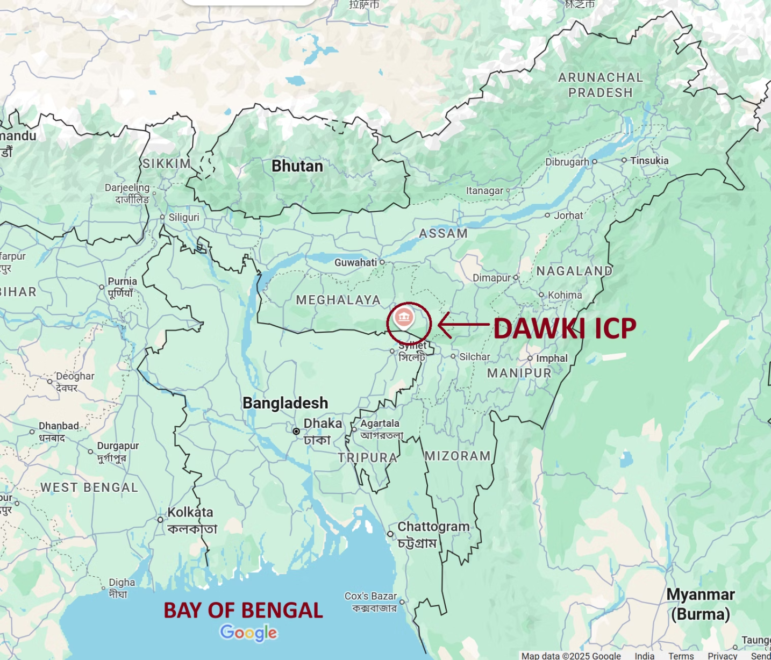
Gaps in Existing Research & Policy
Key Research Gaps
No empirical assessment of Dawki ICP’s performance post-2023 modernization.
Limited analysis of how infrastructure upgrades actually improved trade efficiency.
Revenue dynamics of LPAI remain underexplored — heavy reliance on parking & weighment not fully studied.
Stakeholder perspectives are missing: exporters, truckers, logistics providers, border officials not adequately captured.
Lack of real-time trade data analysis to measure clearance times, truck throughput, and cost savings.
Absence of evidence-based policy recommendations to guide Dawki’s role in BBIN & Act East trade frameworks

Slide 4
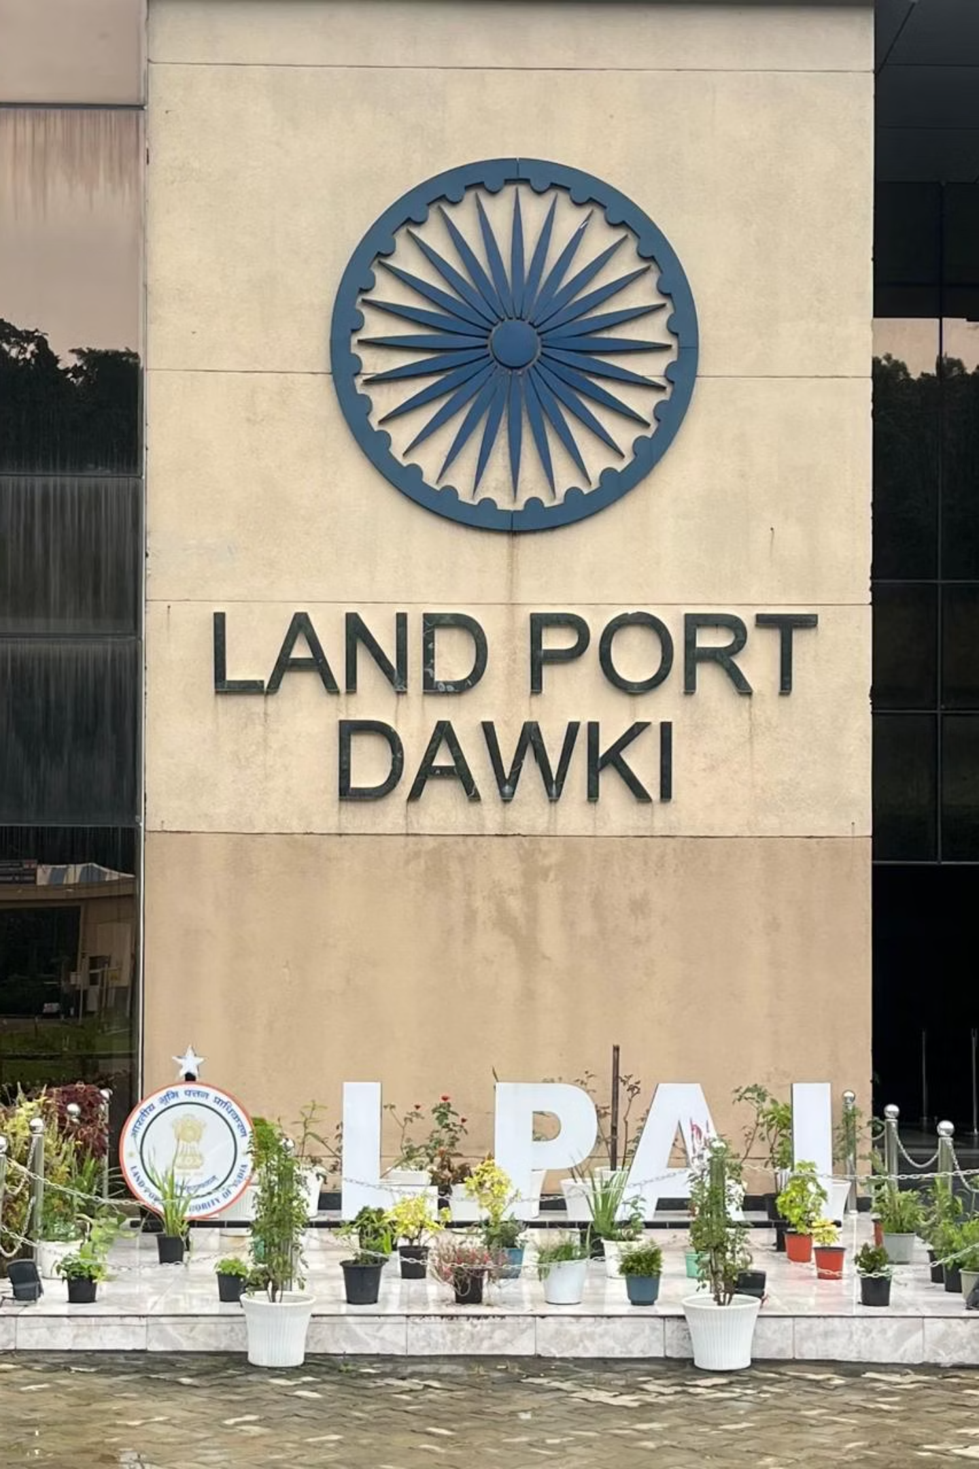
Objective
Positioning Dawki ICP as the strategic gateway of Northeast India, leveraging its unique location.
Highlight modernization gains — improved connectivity and upgraded facilities enabling greater capacity.
Showcase trade performance through Export-Import statistics as the core measure of ICP effectiveness.
Assess revenue sustainability by linking Trade flows, passenger movements, and truck operations to LPAI earnings.
Demonstrate Dawki’s regional potential under BBIN framework, enhancing cross-border economic integration.
Emphasize connectivity to Chattogram Port, unlocking access to multiple countries and amplifying Dawki’s strategic value.

Slide 5
Field Visit & Ground-Level Data Collection
1
On-Site Assessment (Dawki ICP)
Conducted direct observations of cargo flow, parking yards, weighbridge, documentation counters, and operating hours.
Identified infrastructure gaps (bridge limits, Roads shortfall, cold-chain absence) and procedural bottlenecks (multi-desk clearance, digitization gaps).
2
Stakeholder Interactions
Customs & Border Officials – operational workflows, clearance delays, digitization progress.
Exporters, & Truckers – challenges in queueing, costs, and transshipment.
LPAI Port Manager – constraints in warehousing, testing, and multimodal connectivity.
Reviewed official statistics of LPAI, Customs, Immigration, and local trade bodies
3
Institutional Consultations
Met with Department of Industries & Commerce, Shillong (Deputy Director) for regional trade insights.
4
Data Triangulation
Primary Data – Questionnaire responses & stakeholder feedback.
Secondary Data – Official statistics (trade values, truck movement, revenue) and policy documents.
Cross-validated both sets to ensure accuracy and balanced perspectives.

Slide 6
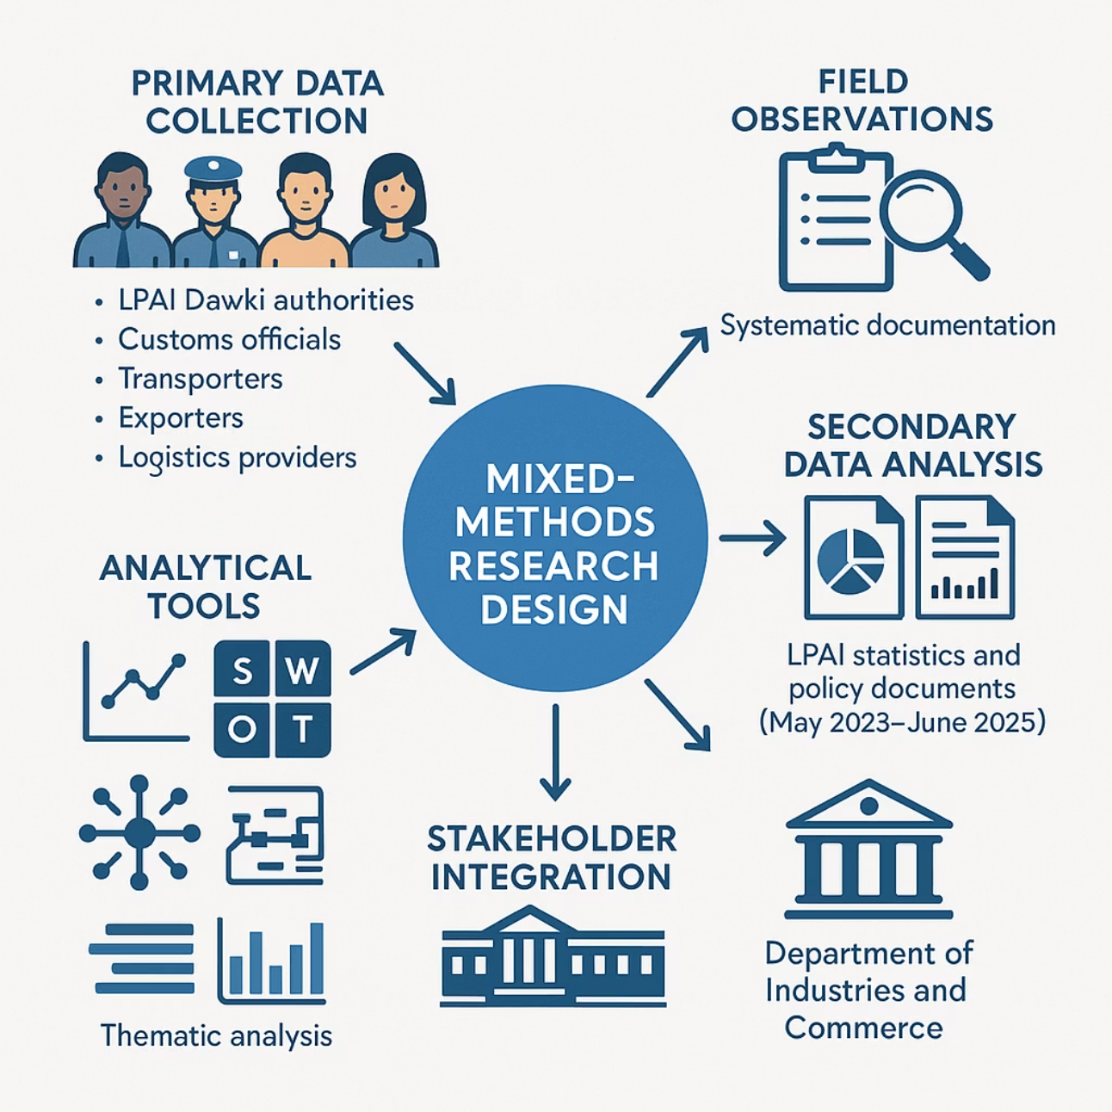
Methodology.
Mixed-Methods Design : I adopted a mixed-methods approach, combining quantitative trade data with qualitative stakeholder perspectives. This ensures a balanced view of both measurable efficiency gains and lived operational realities.
Primary Data Collection
Structured interviews with customs officials, exporters, transport unions, and logistics providers, supported by direct field observations of infrastructure use and procedural workflows.
Secondary Data Analysis
Assessment of official LPAI trade statistics, customs records, and policy documents (May 2023–June 2025) to capture trends over time.
Analytical Toolkit
Time-series analysis for trade dynamics, SWOT assessment for strengths and risks, supply chain mapping, and thematic analysis of stakeholder responses.

Slide 7




Assessment Framework
1.Bottleneck Identification
2.Current Trade Dynamics
Identify specific infrastructural and procedural constraints limiting optimal trade facilitation.
Assess operational efficiency at Dawki ICP, highlighting tangible post-modernization improvements and persisting inefficiencies.
3.Revenue Performance & Sustainability
4.Strategic Alignment
Analyze LPAI’s revenue model — composition, dependence on truck flow, trends in parking & weighment income, and opportunities for diversification to ensure financial sustainability.
Examine how Dawki’s modernization links with regional trade frameworks (BBIN, IMT) and explore its role in enabling direct connectivity to Chattogram seaport.

Slide 8


Primary Data Findings : Field Visit Evidence
1
Infrastructure & Physical Bottlenecks
2
Procedural, Digital & Policy Gaps

Slide 9
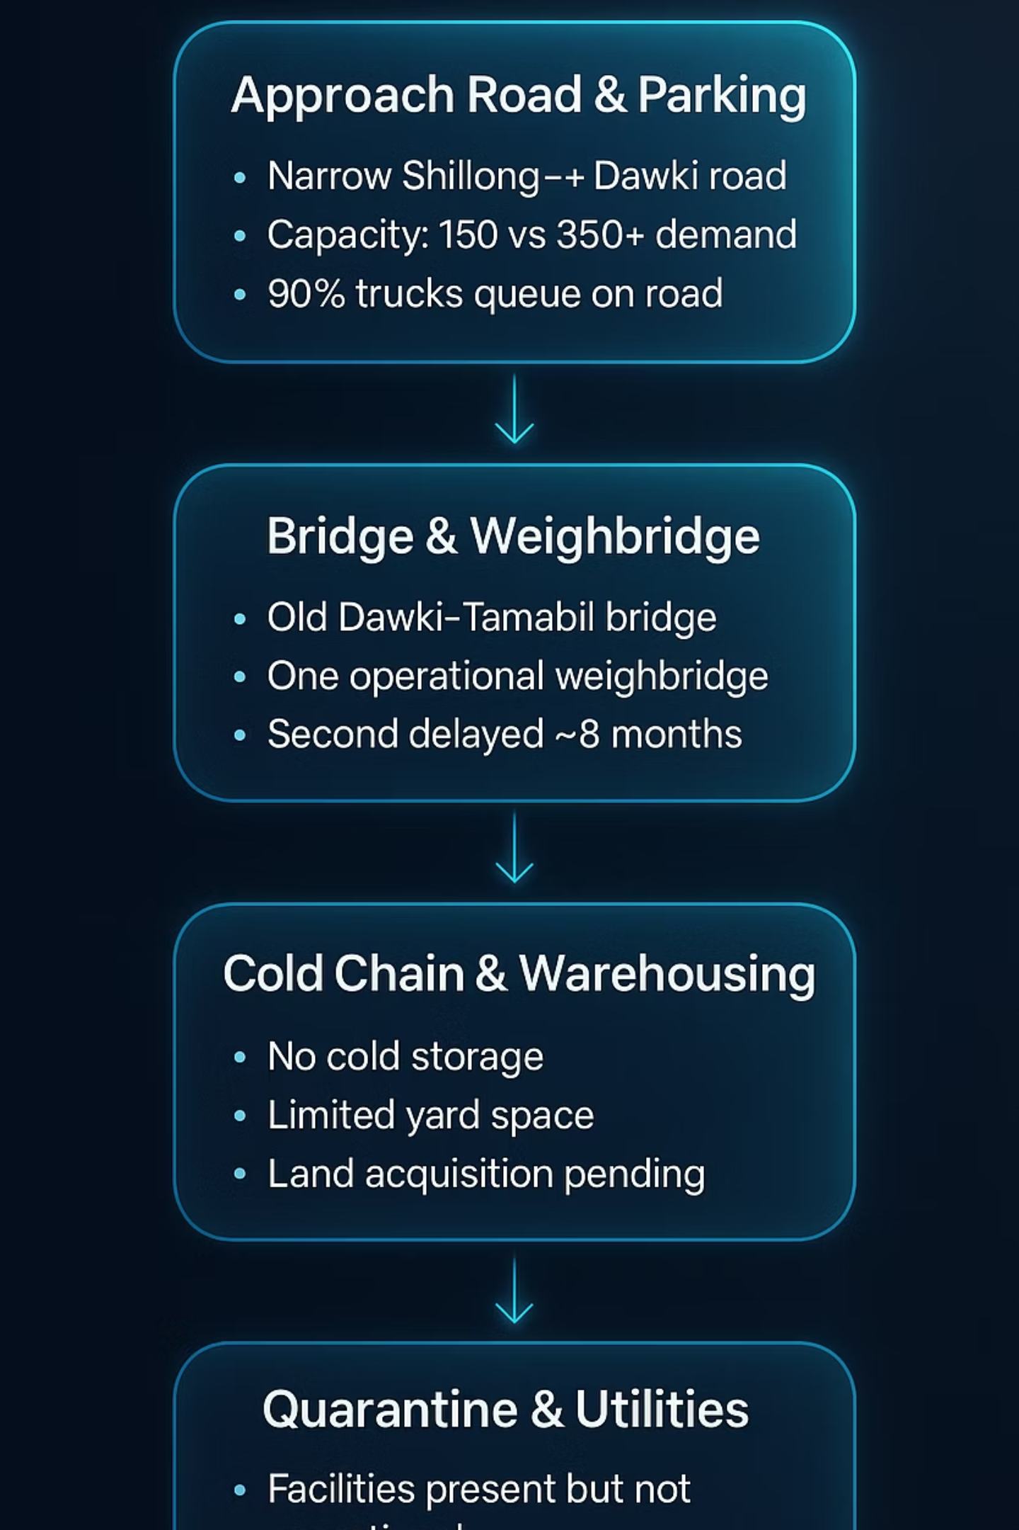
Infrastructure & Physical Bottlenecks
Approach road & parking : The road is narrow and congested, with queues extending into the town. Current parking capacity (~150 trucks) is far below anticipated demand (~350+ once mineral exports scale). As a result, nearly 90% of trucks wait on the road, creating local disruptions and inefficiencies. If trade scales expect 800 trucks.
Bridge & weighbridge : The Dawki–Tamabil bridge remains an old, limited-capacity structure. Only one weighbridge is functional, while the second unit is delayed by ~8 months, slowing truck clearance and reducing throughput.
Cold chain & Pending Land Acquisitions : The ICP lacks cold storage facilities, making perishable trade unviable. Existing warehousing and yard space are also insufficient, with land acquisition and approvals still pending for expansion. (Solar infra)
Quarantine & Testing utilities : Plant and Animal Quarantine units does not exist need to send to different districts. This undermines Dawki’s potential to handle agri and perishable exports effectively.

Slide 10
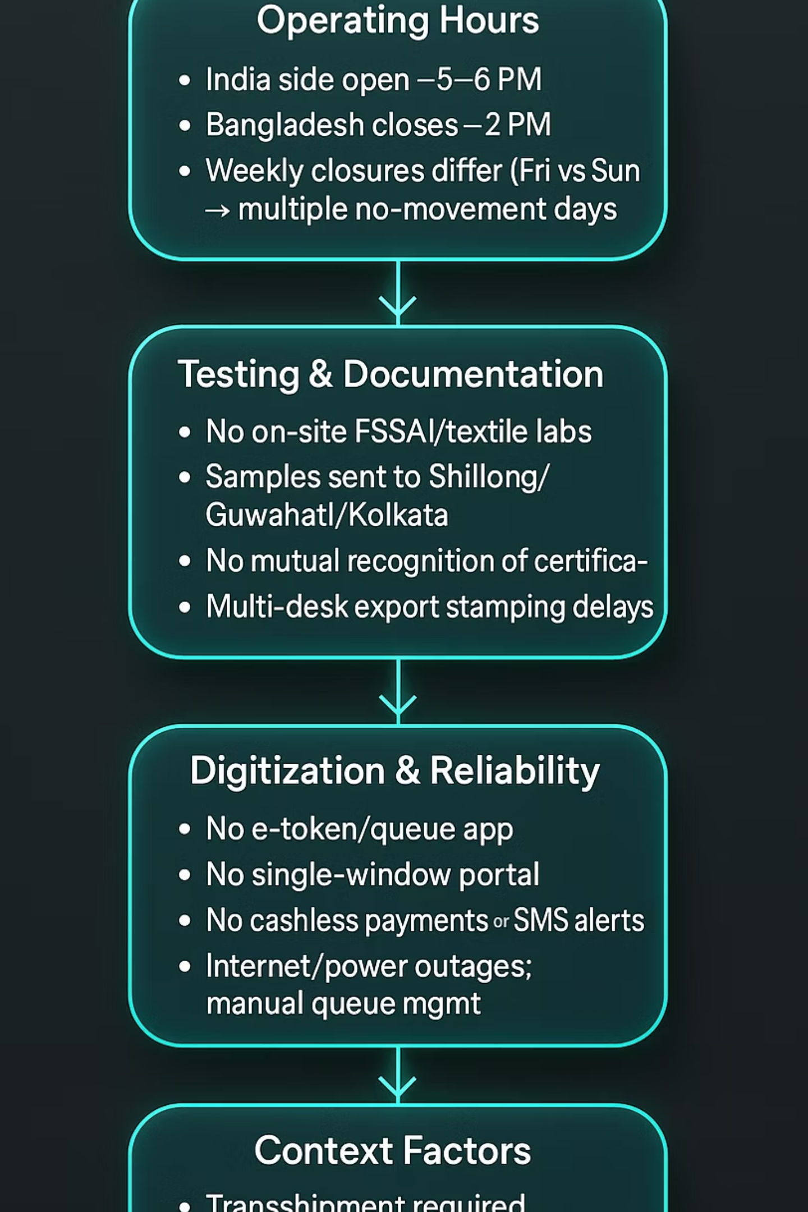
Procedural, Digital & Policy Gaps
Operating hours : India’s ICP operates until 5–6 PM, while Bangladesh closes by 2 PM. Weekly closures differ (Friday vs. Sunday), creating multiple no-movement days and lost trade opportunities.
Testing & documentation : Absence of on-site FSSAI/textile labs forces samples to be sent to Shillong, Guwahati, or Kolkata. No mutual recognition of certificates between India and Bangladesh. Exporters cite multi-desk stamping as the single largest procedural delay.
Digitization & reliability : No e-token system, queue app, or single-window portal. Cashless payments and SMS alerts are absent. Frequent internet/power outages force manual queue management. When documentation is complete, per-truck clearance is <10 minutes — proving that digitalization could transform efficiency.
Context factors : Certain goods still require transshipment. The BBIN Motor Vehicle Agreement (MVA) is not routinely operationalized for through-trucking. Stakeholders also flagged the August 2024 regime change as impacting operational consistency.

Slide 11



Secondary Data : Trade Performance of the Dawki ICP Analysis by Official Statistics
Current trade dynamics are assessed through secondary data analysis, using official statistics from LPAI, Customs, and trade departments.
1
Export / Import Value Analytics
2
Passenger & Truck Movement Analytics
3
Dawki ICP Revenue Analytics

Slide 12
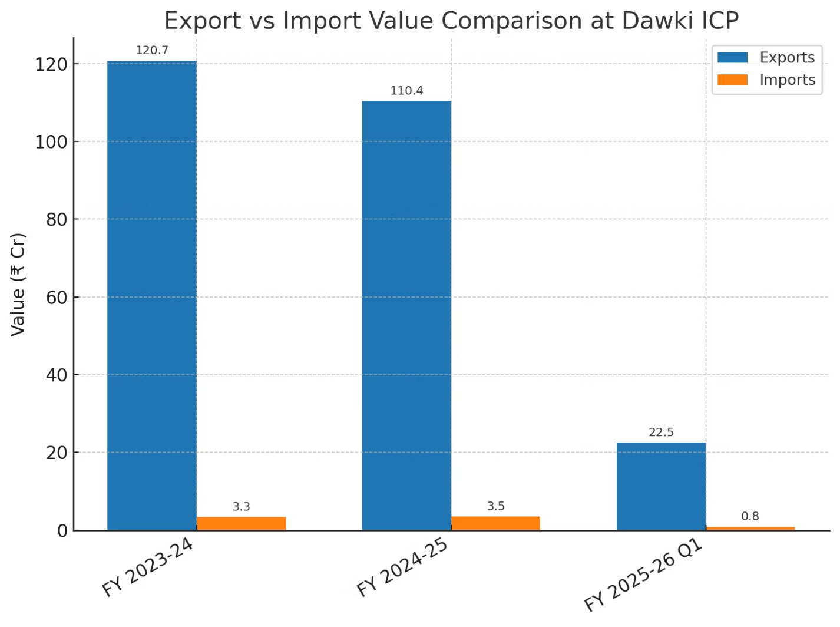
Trade Performance of the Dawki ICP.
Trade Performance
Exports Drive the Corridor FY 2023–24: ₹120.7 Cr, FY 2024–25: ₹110.4 Cr (slight dip, driven by slowdown in minerals) , FY 2025–26 Q1: ₹22.5 Cr in just 3 months, signaling a strong recovery if pace continues.
Growth/Decline Trends
Slight dip in total export value FY 24-25 due to mineral slowdown.
Q1 FY 25-26 already shows ₹22.5 Cr exports in 3 months → strong outlook if pace sustains.
Imports remain marginal, not a growth driver.
Strategic Takeaway
Dawki ICP is firmly an export-driven corridor with exports exceeding imports by 30x (₹120.7 Cr vs ₹3.3 Cr in FY 23–24).
Despite a 7–9% dip in FY 24–25 due to mineral slowdown, diversification signals resilience. Q1 FY 25–26 already achieved ₹22.5 Cr exports in just 3 months → if sustained, annualized value could exceed ₹90 Cr, proving Dawki’s potential to rebound.
Imports remain negligible (<5%), confirming Dawki’s role as a one-way export gateway, not a balanced trade corridor.

Slide 13
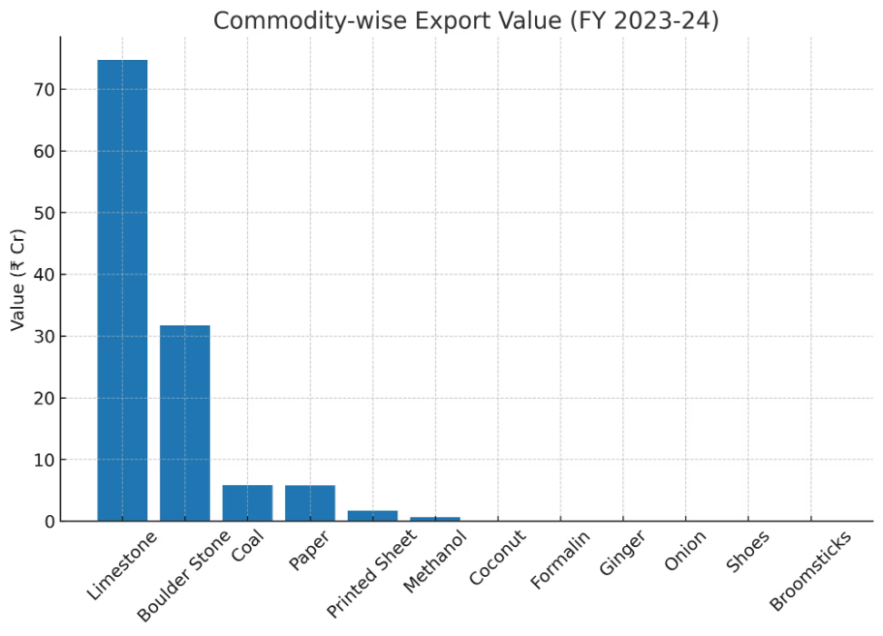
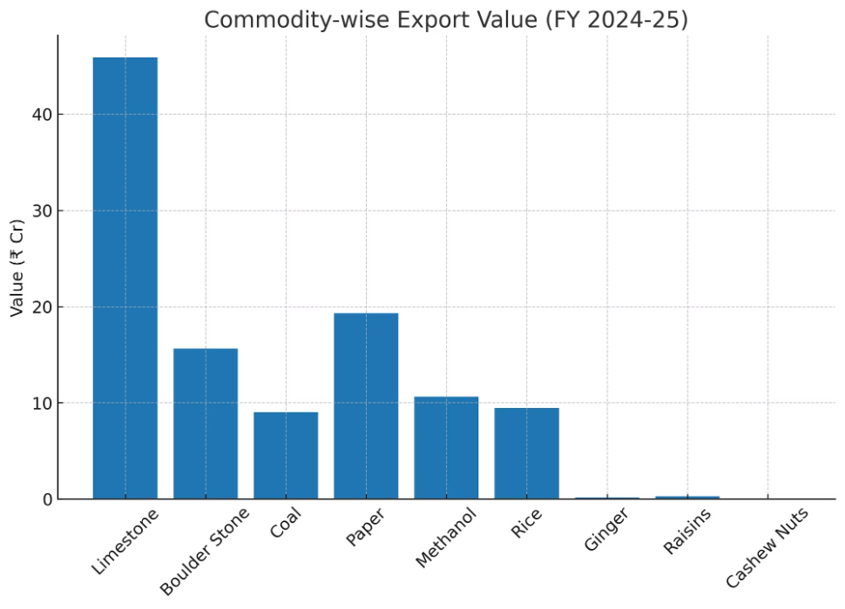
Export Value Analytics:
Export Profile (₹115.3 Cr) : FY 23-24.
Export Profile (₹110.4 Cr, slight dip) : FY24-25
Minerals dominate: Limestone (₹74.7 Cr) + Boulder Stone (₹31.7 Cr) = ~92% of value.
Limestone ↓ (₹74.7 Cr → ₹45.9 Cr).
Coal (₹5.8 Cr) and Paper (₹5.8 Cr) = secondary contributors.
Boulder Stone ↓ (₹31.7 Cr → ₹15.6 Cr).
Other commodities (printed sheets, methanol, coconut, onion, broomsticks, etc.) negligible (<2%).
Industrial & Agri diversification:
Paper ↑ (₹19.3 Cr, 3x growth).
Methanol ↑ (₹10.6 Cr, 16x growth).
Rice (₹9.5 Cr) entered strongly.
Minor entrants: Raisins (₹0.28 Cr), Cashew (₹0.01 Cr).
Strategic Takeaway:
Dawki ICP is transitioning from a mineral-heavy corridor to a diversified export hub.
Industrial (paper, methanol) and agri (rice, raisins) goods are emerging as new growth engines, reducing dependence on bulk minerals.
Diversification signals greater long-term resilience despite short-term value dips.

Slide 14
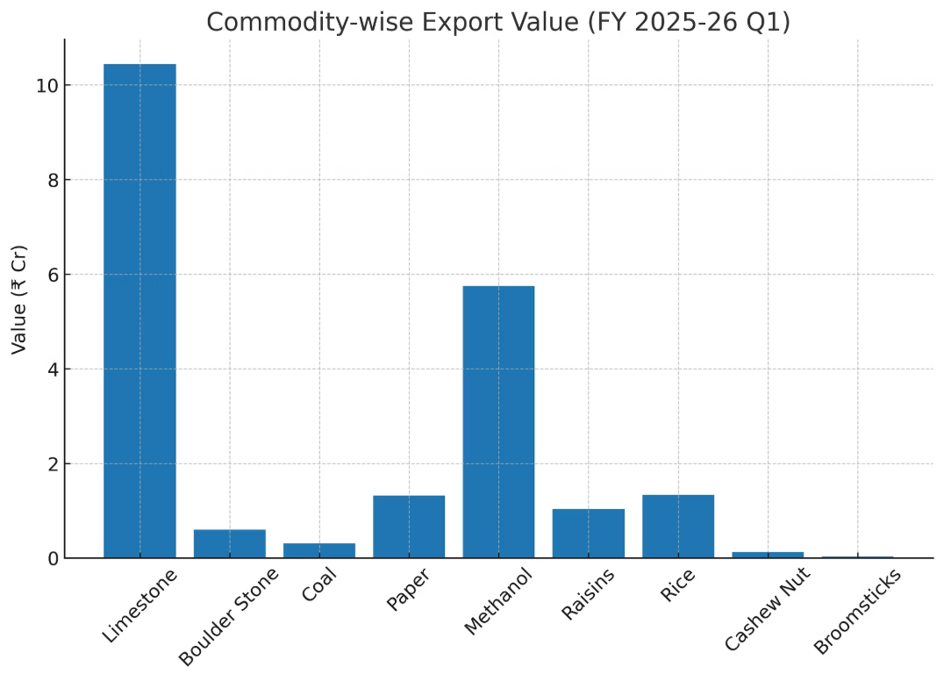
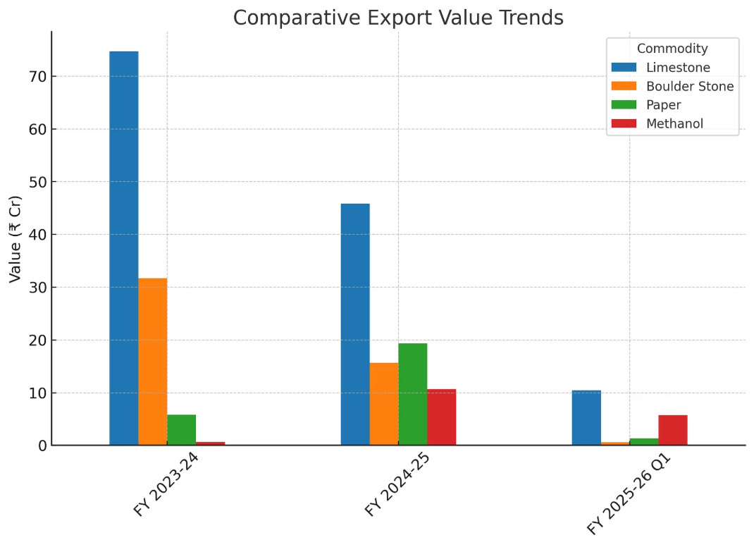
Export Profile (₹22.5 Cr in 3 months)
Key Insights :
Limestone (₹10.4 Cr) still dominant, but share down to ~46%.
Shift from bulk minerals → diversified mix (paper, methanol, Agri).
Methanol (₹5.7 Cr) & Paper (₹1.3 Cr) strong contributors.
Data shows limestone & boulders losing share, replaced by higher-value industrial/Agri goods.
Rice (₹1.3 Cr) & Raisins (₹1.0 Cr) continue traction.
Broomsticks reappear, though marginal.
Explosive growth in Methanol (+1500%) & Paper (+230%) FY23→FY24.
Agri (rice, raisins) adding new revenue lines.
Long-term: ICP evolving from single-commodity corridor → multi-commodity hub under BBIN/Act East.
Strategic Takeaway:
Dawki ICP is steadily shifting from bulk mineral exports to a diversified industrial and agri mix.
The emergence of paper, methanol, and agri-products shows a structural rebalancing in trade composition.
Long-term trajectory positions Dawki as a multi-commodity hub under BBIN & Act East frameworks, reducing fragility from single-commodity dependence.

Slide 15
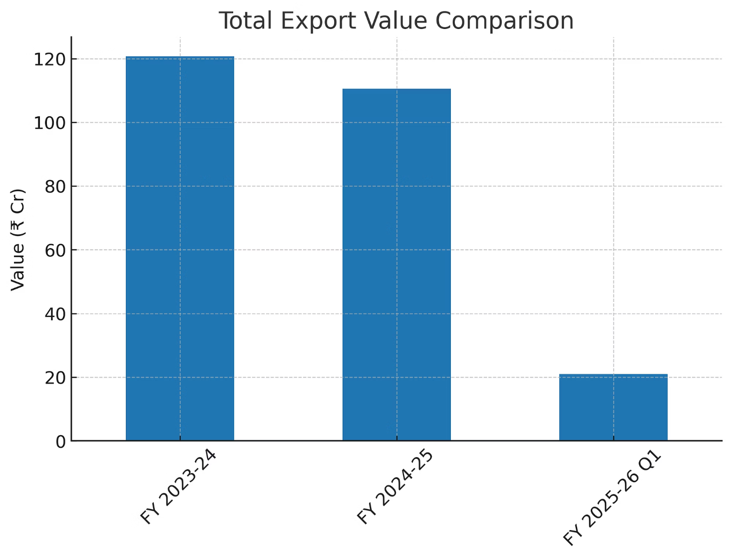
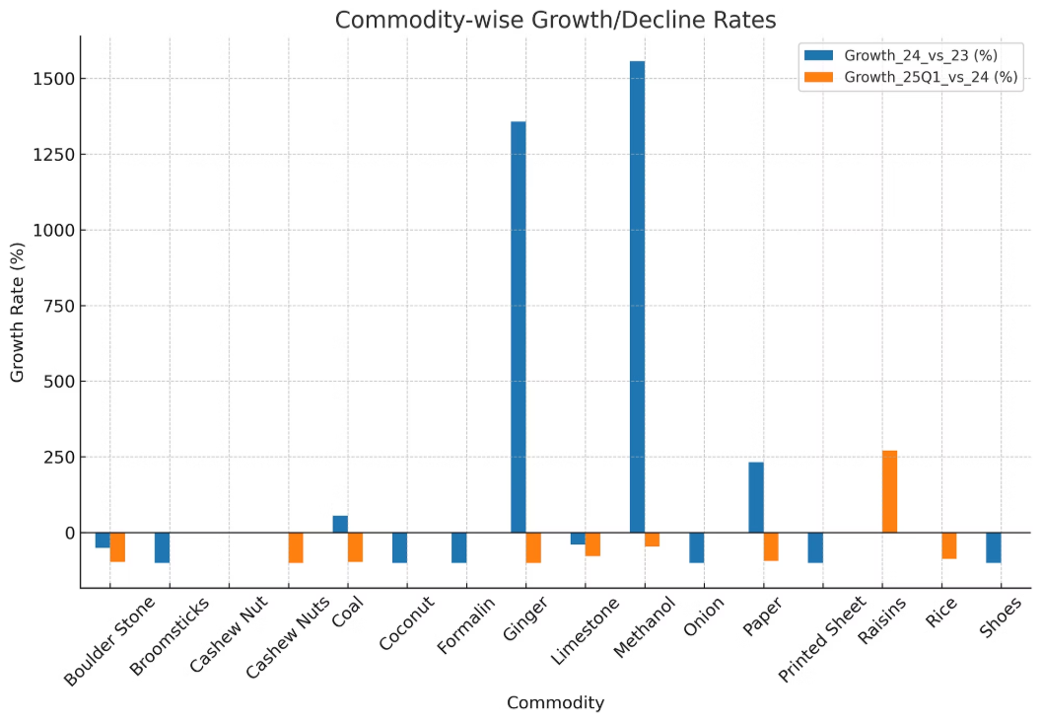
Growth/Decline Insights
Declines: Limestone & Boulder Stone down by ~35–50%.
Growth Engines: Paper ↑ 230%, Methanol ↑ 1500%, Rice & Raisins emerged.
Net Effect: Export value dipped slightly, but commodity base diversified.
Performance Overview
FY 2023-24: ₹120.7 Cr (strong opening year).
FY 2024-25: ₹110.4 Cr (↓ ~9%) → driven by fall in limestone & boulder stone.
FY 2025-26 Q1: ₹22.5 Cr in 3 months (if sustained → ~₹90 Cr annualized).
Strategic Takeaway
Trend shows ICP transitioning from mineral-dependent to multi-commodity hub, improving long-term resilience.
Even with value fluctuations, new growth engines (industrial & agri goods) are balancing declines in minerals.
Long-term trajectory points to a more sustainable, multi-commodity export hub rather than a fragile, single-sector corridor.

Slide 16
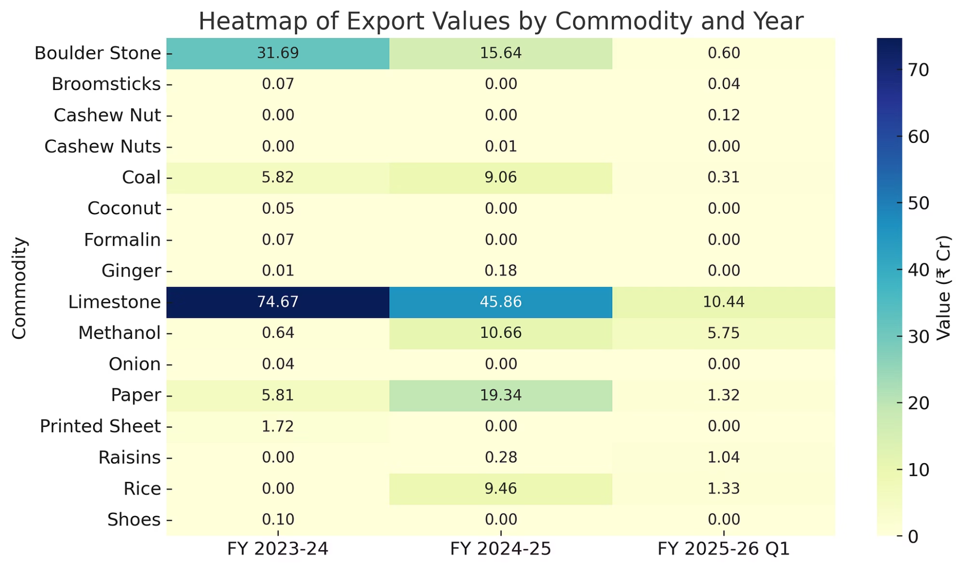
Opportunities
Heat Map:
Pushing industrial exports (chemicals, processed goods) to stabilize revenue.
Scale agri-trade (rice, spices, raisins, niche crops) leveraging cross-border demand.
Position ICP as a multi-commodity trade hub.
Strategic Potential
ICP can serve as a regional trade accelerator for Northeast India, linking minerals, agri, and industrial goods into Bangladesh and beyond.
Long-term: Transitioning from a single-commodity corridor → diversified supply-chain hub under BBIN & Act East Policy.

Slide 17
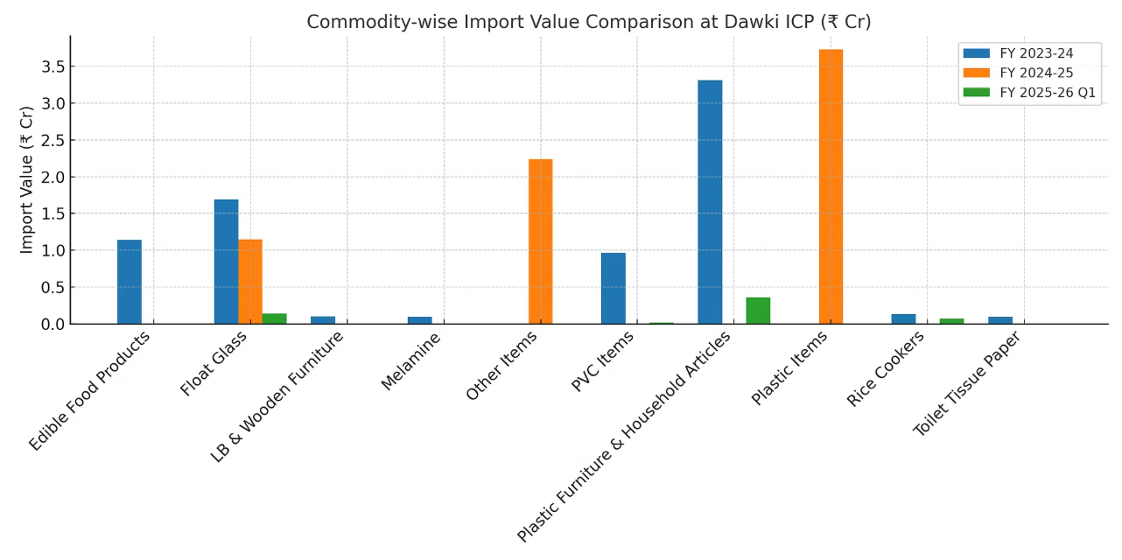
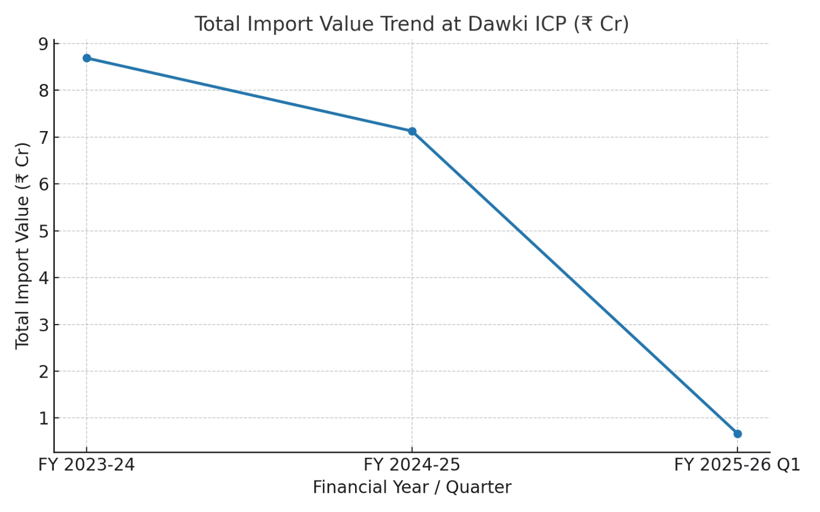
Import Value Analytics:
Commodity-wise Import Value Comparison (₹ Cr) : This bar chart compares the major import commodities across FY 2023-24, FY 2024-25, and Q1 2025-26.
Total Import Value Trend (₹ Cr) : This line chart shows how total import value has evolved:
Plastic goods dominate imports consistently (highest share across all years).
FY 2023-24: ₹8.69 Cr
Float Glass remains the second major import category.
FY 2024-25: ₹7.13 Cr (↓ 18% decline)
Minor items like PVC, Rice Cookers, Melamine, and Tissue Paper appear intermittently, showing lower but steady demand.
Q1 2025-26: ₹0.67 Cr (further downtrend, ~₹0.22 Cr/month average)

Slide 18
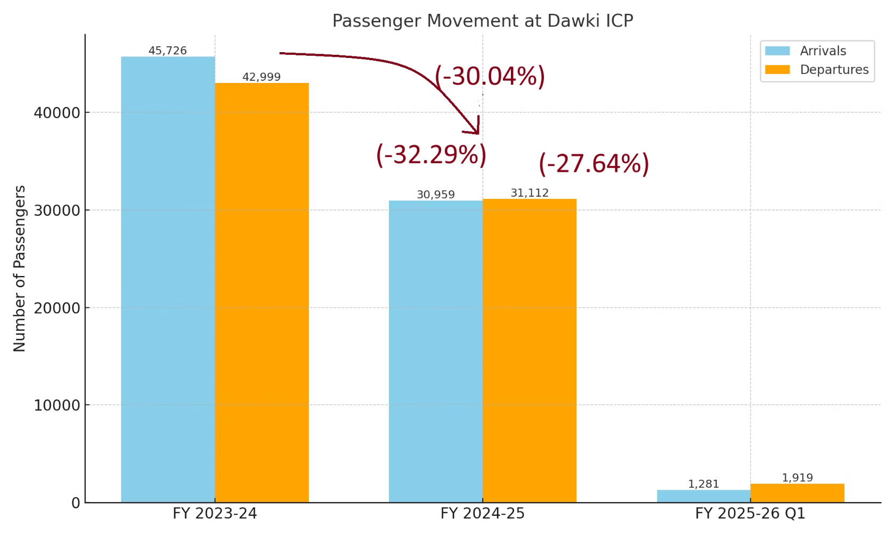
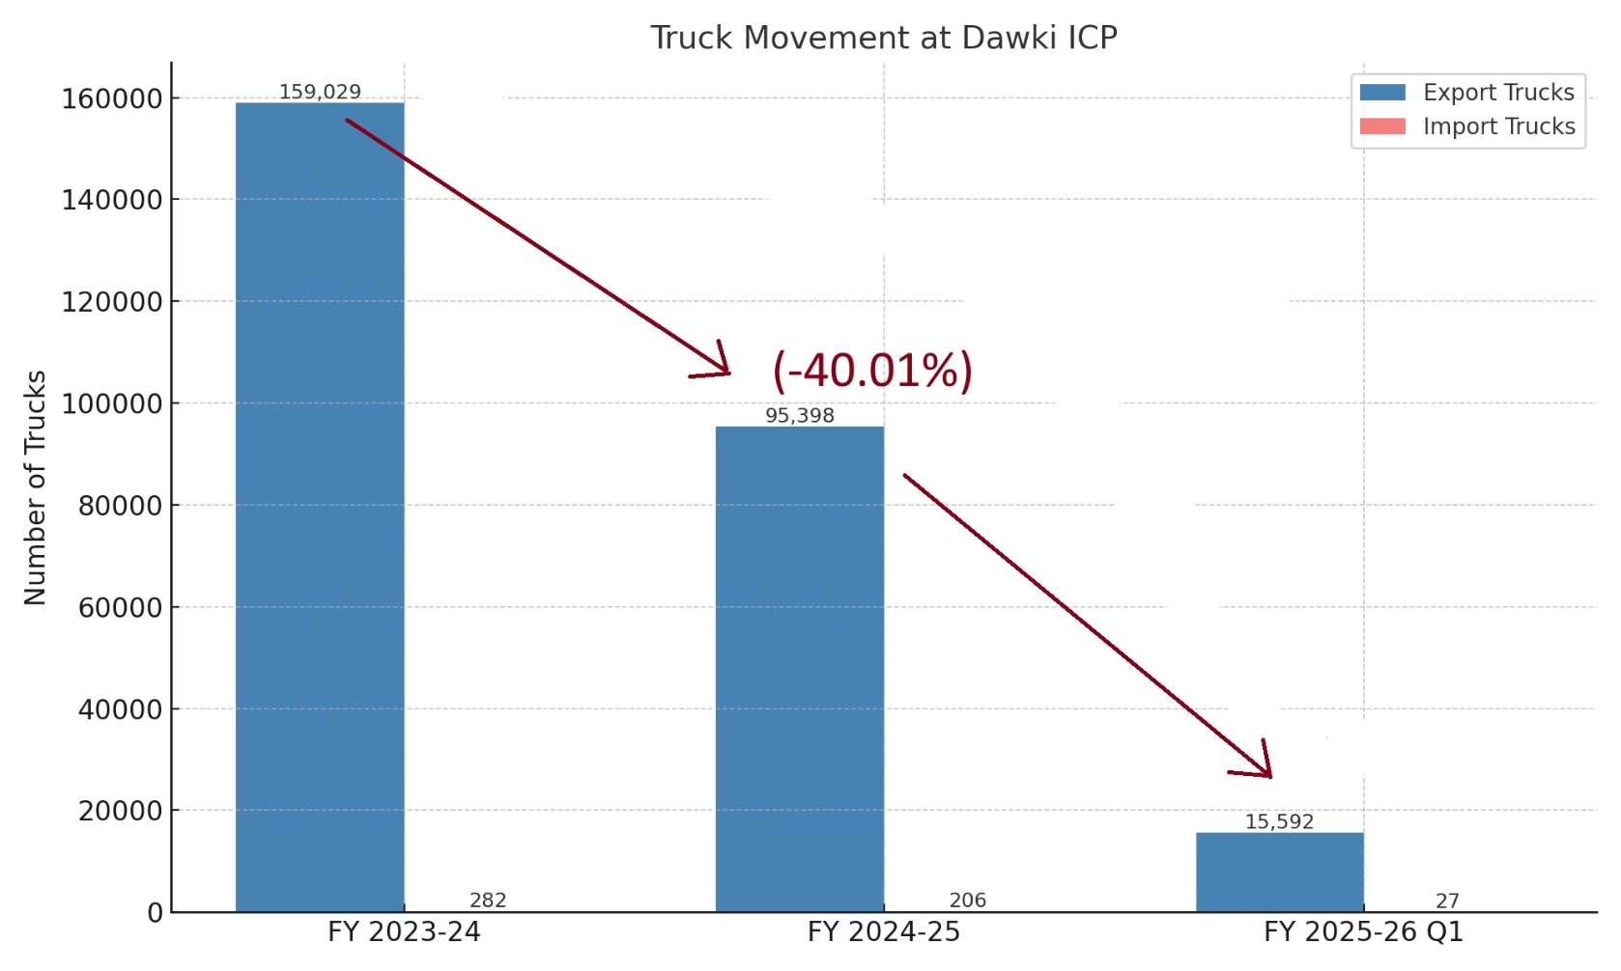
Passenger & Truck Movement Analytics
Passenger Migration
Truck Movement
FY 2023-24 → 45,726 arrivals / 42,999 departures
FY 2023-24 → 1.59 lakh export trucks.
FY 2024-25 → 30,959 arrivals / 31,112 departures
FY 2024-25 → 95,398 export trucks (↓40%).
FY 2025-26 Q1 → 1,281 arrivals / 1,919 departures
FY 2025-26 Q1 → just 15,592 export trucks, sharp contraction.
Strategic Insight
Dawki ICP’s throughput is in crisis → lower cargo & people flows directly erode revenue.
This undermines ICP’s ability to be self-sustaining, especially with fixed operating costs.
Structural risks: Dependence on minerals, limited diversification of traffic.

Slide 19
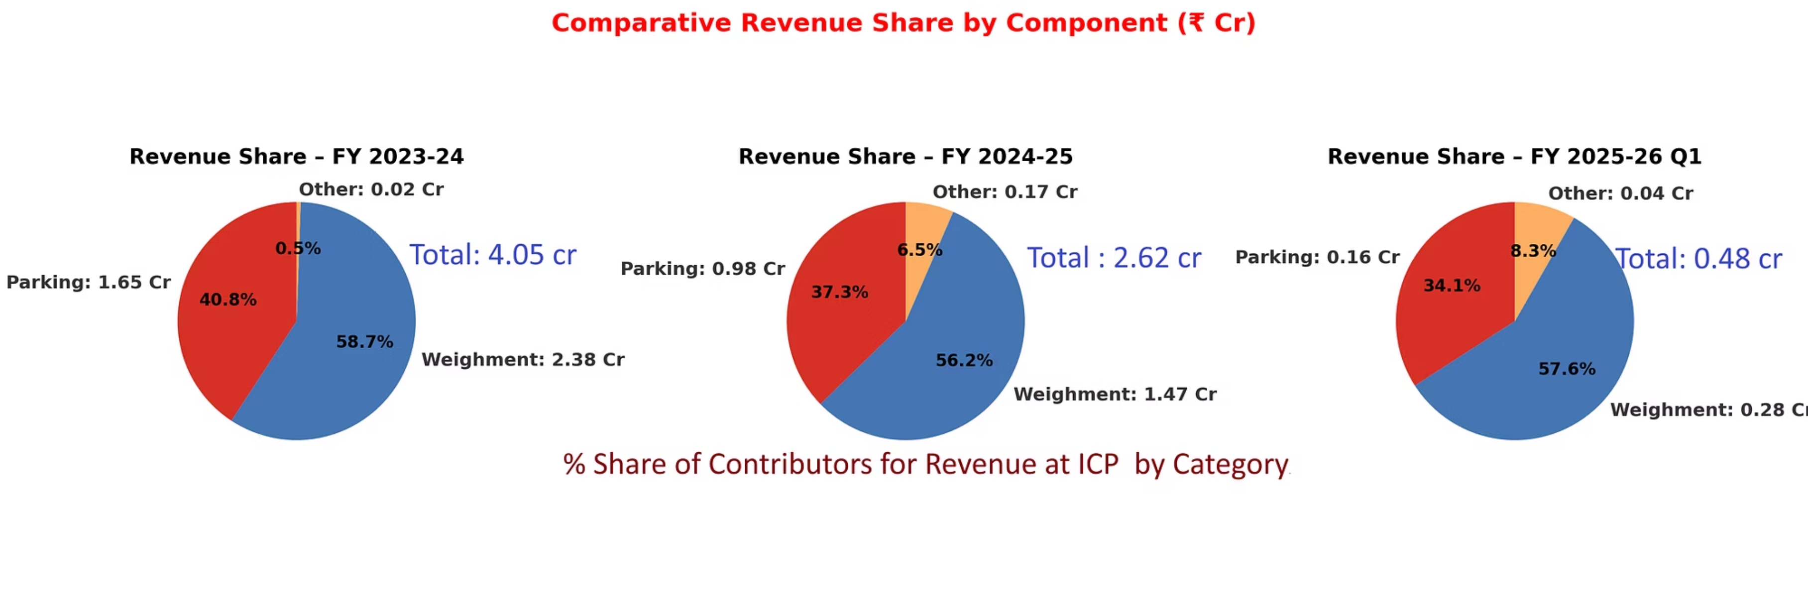
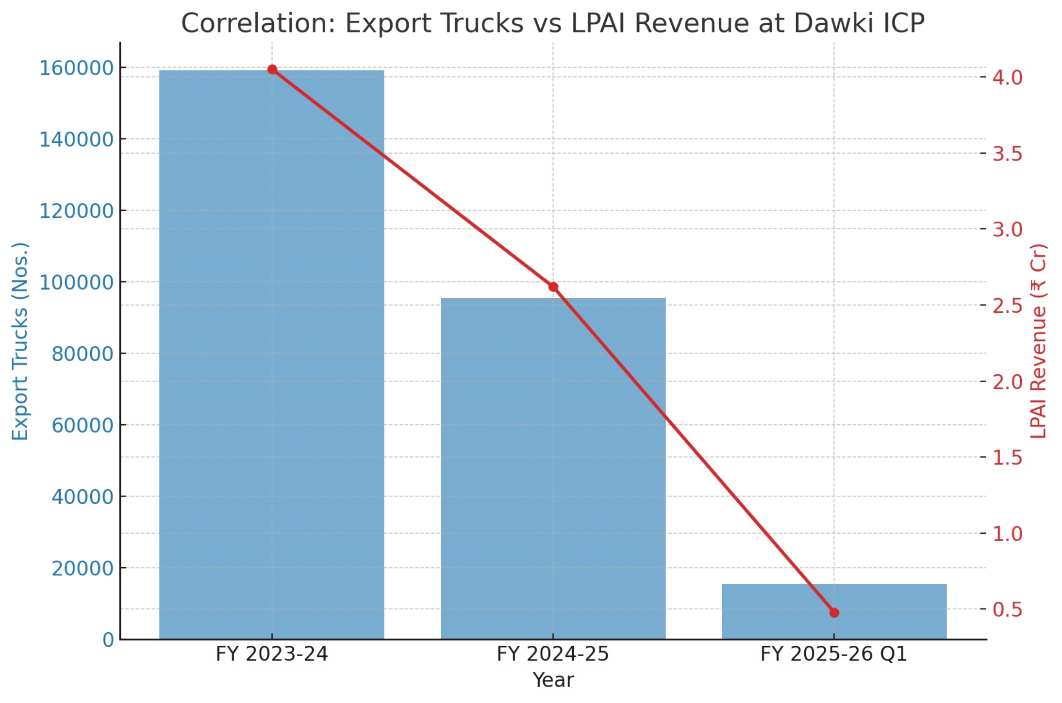
Dawki ICP Revenue Analytics
Key Facts
FY 2023-24: ₹4.05 Cr (Parking ₹1.65 Cr, Weighment ₹2.38 Cr).
FY 2024-25: ₹2.62 Cr (↓35.3%).
FY 2025-26 Q1: ₹0.48 Cr in 3 months (annualized pace = <₹2 Cr).
Revenue Share:
Weighment : 56–58% share. Parking declining share (40.8% →37.3→ 34.1%).
“Other” rising (0.5% → 8.3%), but too small to offset losses.
Strategic Insight
Dawki ICP’s core revenue engines (Parking & Weighment) are collapsing in tandem with falling truck movement.
Without cargo growth, LPAI Dawki revenue risks becoming unsustainable.
Alarming reality: ICP may not be able to self-sustain operational costs unless trade rebounds or revenue streams diversify.

Slide 20
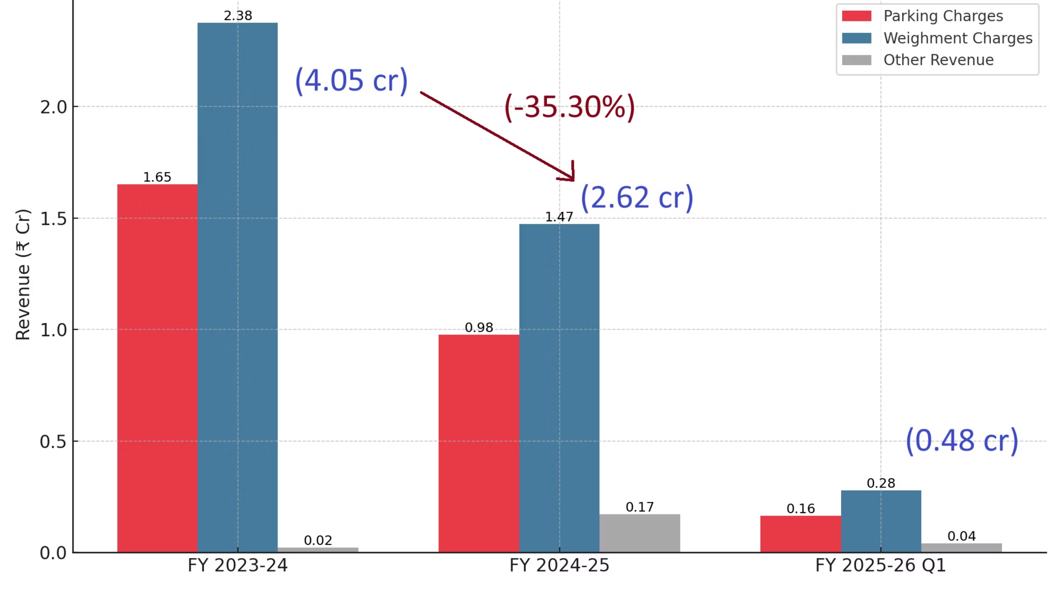

Slide 21
3.Strategic Insights for Sustaining LPAI Revenue at Dawki ICP
1
Revenue in Freefall — Urgent Stabilization Needed
Dawki’s revenue has collapsed from ₹4.05 Cr (2023–24) to ₹2.63 Cr (2024–25) and just ₹0.48 Cr in Q1 2025–26 — an 88% decline in two years. This trajectory signals not a temporary dip but a structural crisis that threatens the port’s financial sustainability.
2
Overdependence on Truck Flow = Structural Fragility
More than 90% of revenue comes from parking and weighment fees, making LPAI’s income model entirely hostage to truck throughput. As truck volumes halved last year, revenues plunged in parallel — exposing a brittle, one-dimensional revenue structure.
3
Unlock Throughput by Fixing Infrastructure Bottlenecks
Current capacity of ~150 parking slots is far below demand (350+ trucks). Similarly, a single weighbridge creates costly delays. Expanding parking yards and operationalizing a second weighbridge would directly raise truck throughput and double weighment revenue potential.
4
Synchronize Border Hours to Capture Lost Trade Days
India’s gate remains open till 5–6 PM, while Bangladesh closes by 2 PM. This mismatch wastes up to two trade days per week. A bilateral policy push to align timings could significantly increase daily truck clearances, directly boosting parking and weighment income.
5
Diversify Beyond Minerals — Build a Balanced Export Basket
Current trade is dominated by limestone and boulders, creating volatility. Scaling industrial exports (paper, methanol) and agri-exports (rice, turmeric, raisins, ginger) would stabilize truck flows, reduce dependency on a single commodity class, and generate steadier revenue streams.
6
Create New Revenue Streams with Value-Added Services
Today, “Other Revenues” account for less than 10%. By deploying digital queue/payment systems (e-token apps, SMS alerts, cashless collections) and investing in cold storage and testing labs, LPAI can unlock new revenue heads — lab fees, storage charges, service charges — while plugging leakages and enabling high-value perishable trade.

Slide 22



4.Strategic Alignment
Strategic Alignment: Policy & Corridor Integration
BBIN Motor Vehicles Agreement
IMT Trilateral Highway
WTO Trade Facilitation
Signed in 2015, aims for seamless truck movement across Bhutan, Bangladesh, India, and Nepal.
Strategic corridor linking India’s Northeast with Myanmar and Thailand.
India and Bangladesh are signatories, yet paperless trade, single-window systems, and joint inspections remain partly implemented, limiting efficiency gains.
Dawki is positioned to serve as a feeder node but connectivity gaps delay operationalization.
Still not fully implemented (Bhutan pending ratification), forcing transshipment at borders and raising costs.
Mandating paperless cross-border trade and reduced clearance delays.
Position Dawki as a node linking Northeast India to ASEAN markets via Myanmar–Thailand.
Can unlock seamless cross-border truck access to Chattogram (~427 km), removing costly transshipment.
Strategic Corridors: Dawki–Tamabil identified for symmetric upgrades under bilateral frameworks; progress is uneven, particularly on the Bangladesh side.
Policy Outcome: Dawki’s role as a strategic integration point under Act East Policy and BBIN frameworks remains under-realized due to incomplete policy execution.

Slide 23
Recommendations & Action Points
1. Infrastructure & Capacity
Fast-tracking existing and upcoming Shillong–Dawki road expansion to ease approach bottlenecks.
Operationalize 2nd weighbridge + yard expansion to raise throughput.
Cold storage & warehousing facilities to unlock agri/perishable exports.
2. Procedural & Digital Reforms
Synchronize India–Bangladesh border hours to capture lost trade days.
Single-window digital clearance (Gate Parking ,Weighbridge, e-token, queue management, cashless systems) to cut delays and increase revenue.
On-site testing labs (FSSAI) with mutual certificate recognition.
3. Trade Diversification & Revenue Model
Scale industrial exports (paper, methanol) and agri-exports (rice, raisins, turmeric) to reduce mineral dependence.
Value-added services (lab fees, storage, logistics hubs) as new LPAI revenue streams.
Introduce PPP(Public–Private Partnership) model models for warehousing, cold-chain, and logistics facilities.
4. Strategic Policy Alignment
Operationalize BBIN Motor Vehicles Agreement for through-trucking to Chattogram.
Finalize transit rules to allow direct Indian truck access to Chattogram; harmonize customs procedures.
Integrate Dawki with IMT Trilateral Highway and PM Gati Shakti multimodal grid.
Position Dawki as a regional trade accelerator under Act East Policy.
5 . Bilateral Coordination & Geopolitical Resilience :
The trade dip post-FY 2024 must be contextualized not as a structural or infrastructural failure, but as a temporary disruption caused by the regime change and political unrest in Bangladesh (August 2024), which significantly affected operational continuity at Tamabil.
To minimize future vulnerability, strengthen Indo–Bangla bilateral coordination through institutionalized corridor management mechanisms such as monthly review meetings, joint Standard Operating Procedures (SOPs), and real-time communication protocols between border authorities.
Enhance Dawki’s resilience to external shocks by establishing diplomatic buffers, alternate logistics contingencies, and embedding geopolitical risk management into trade planning frameworks.

Slide 24
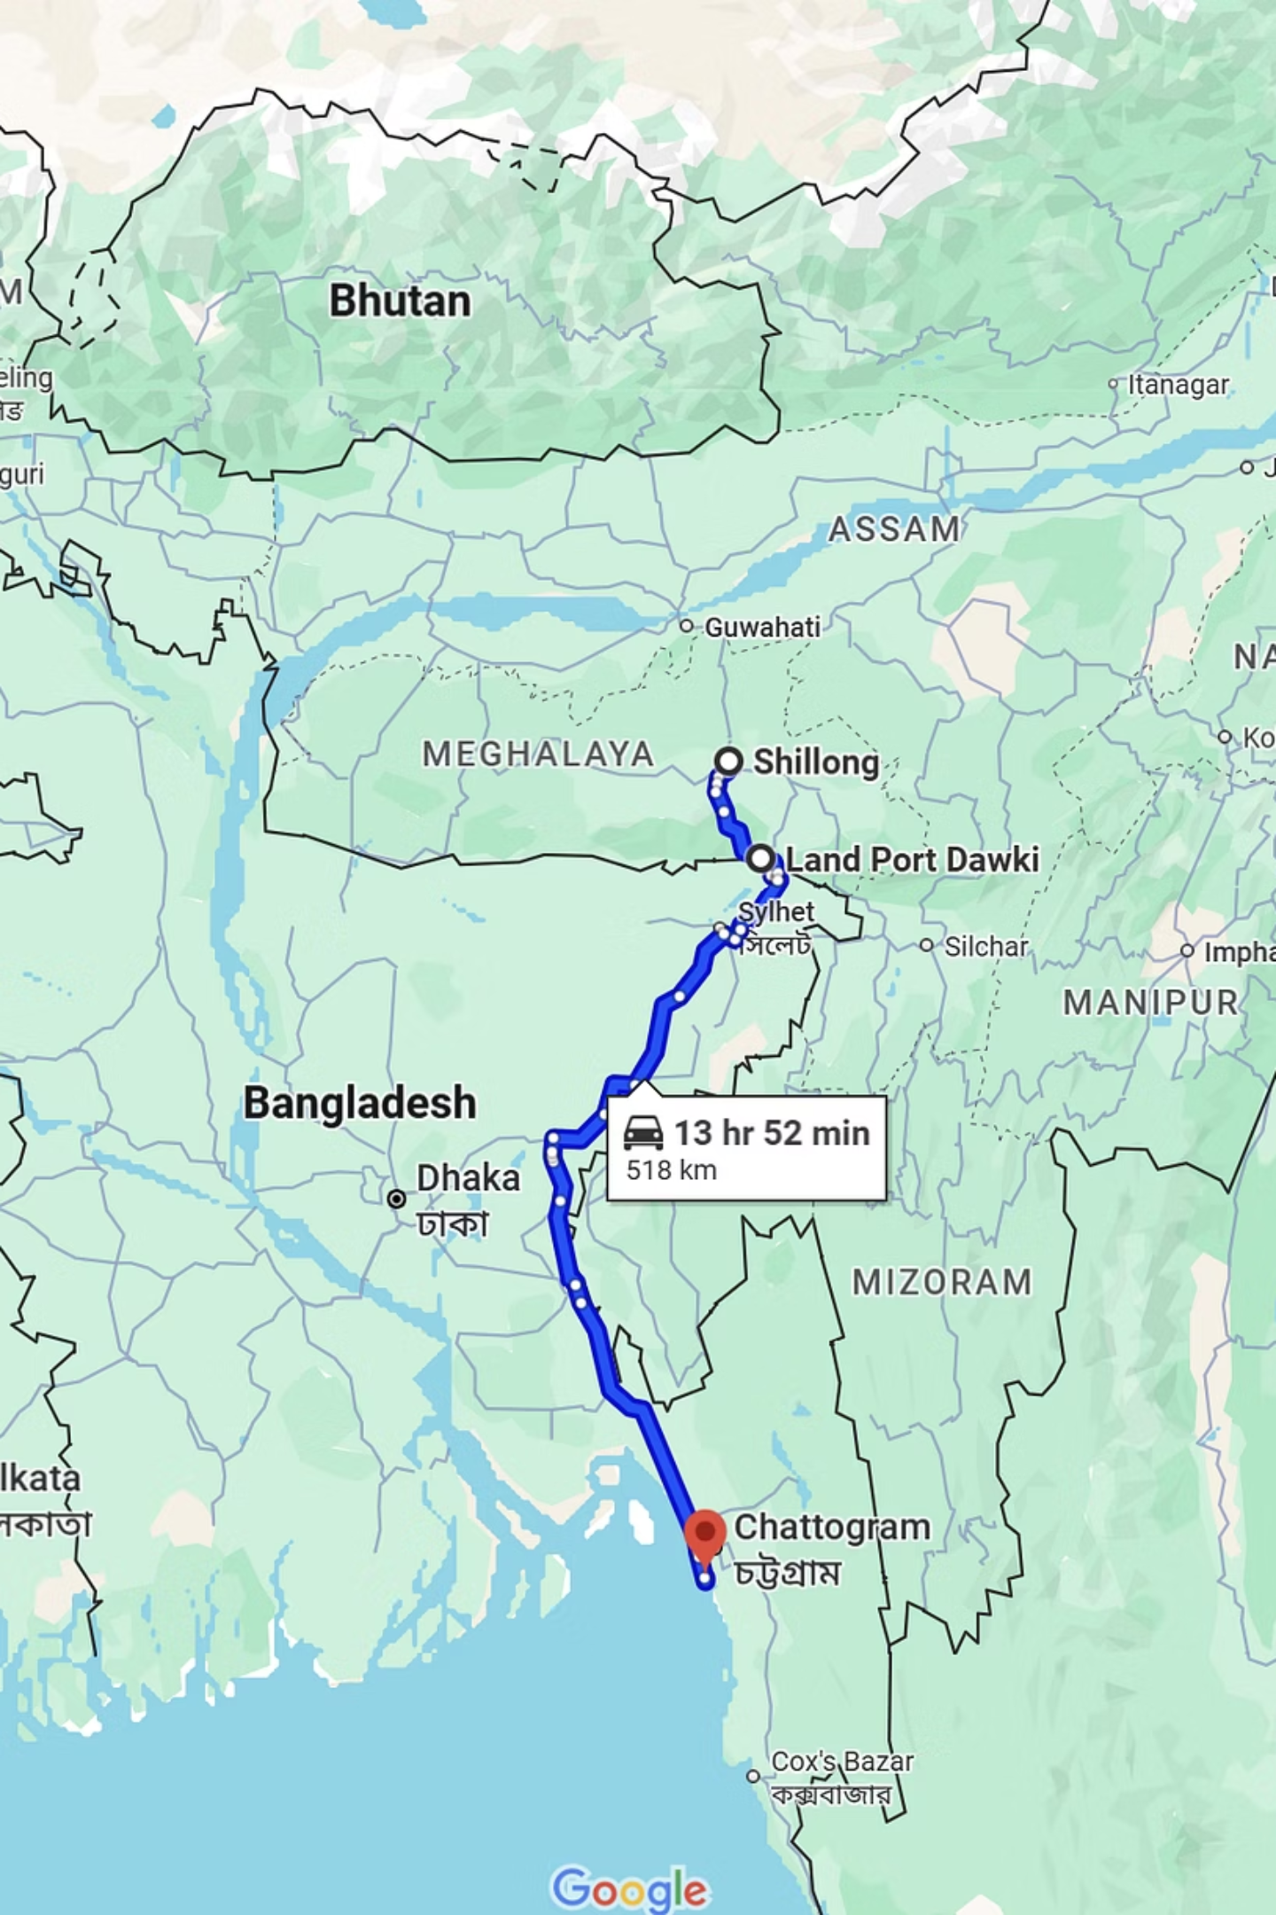
Dawki ICP Vision 2030
Seamless Chattogram Linkage : Direct connectivity eliminates transshipment, enabling Northeast India’s producers to access global markets.
Revenue Sustainability : Higher cargo throughput, diversified export mix, and value-added services (labs, cold storage, digital facilitation) secure LPAI’s long-term viability.
Policy Synergy: Harmonized border hours , digitized clearance, and infrastructure upgrades align with BBIN cooperation and WTO Trade Facilitation mandates.
Strategic Outcome: Dawki transforms from a fragile, mineral-dependent corridor into a resilient multi-commodity hub anchoring India’s Act East Policy.
Vision 2030 Statement: By 2030, Dawki ICP will be positioned as a diversified, multi-commodity, Chattogram-linked gateway, transforming Northeast India’s role in regional and global trade.

Slide 25
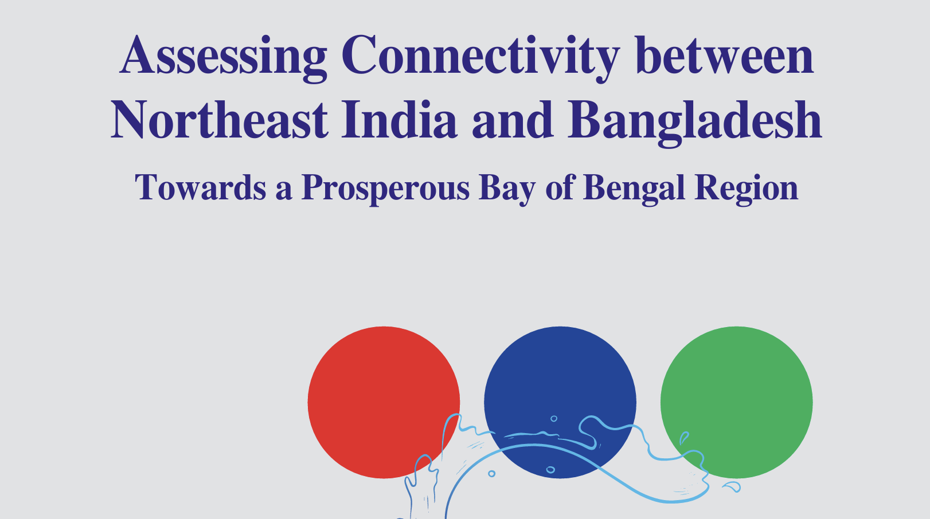
Conclusion
Dawki ICP is no longer just a fragile, mineral-dependent border post—it is strategically positioned to emerge as a resilient, multi-commodity trade hub driving Northeast India’s regional integration under the Act East and BBIN frameworks.
While the decline in trade volumes post-FY 2024 reflects the temporary effects of political unrest and regime change in Bangladesh, field research confirms that Dawki’s structural fundamentals remain strong. With critical investments in infrastructure, digitization, and diversified trade flows, Dawki can evolve into a seamless logistics corridor connecting India’s hinterland to Chattogram Port and ASEAN markets.
The path forward lies in harmonizing bilateral protocols, expanding multimodal access, and reinforcing Dawki’s role as a strategic, secure, and sustainable gateway that unlocks long-term economic opportunities for the Northeast and ensures financial viability for LPAI.
Bibliography
1.Official Reports:
3.Policy Frameworks:
World Bank (2016), “Land Ports and Trade Competitiveness”
BBIN Motor Vehicle Agreement (2015)
ADB (2016), SASEC Operational Plan 2016–2025
India’s Act East Policy
UNESCAP (2020), “Digitization and Trade Facilitation in South Asia”
WTO Trade Facilitation Agreement (TFA)
ERIA (2016), “BBIN Connectivity and Integration Studies”
4.Maps/Visuals:
2.Government Sources:
Google Maps (for Dawki–Chattogram corridor route).
Land Ports Authority of India (LPAI) trade statistics (2023–2025)
Department of Industries & Commerce, Government of Meghalaya (2025). Field Visit Consultation Notes.
Customs & DGFT data

